Slide 1
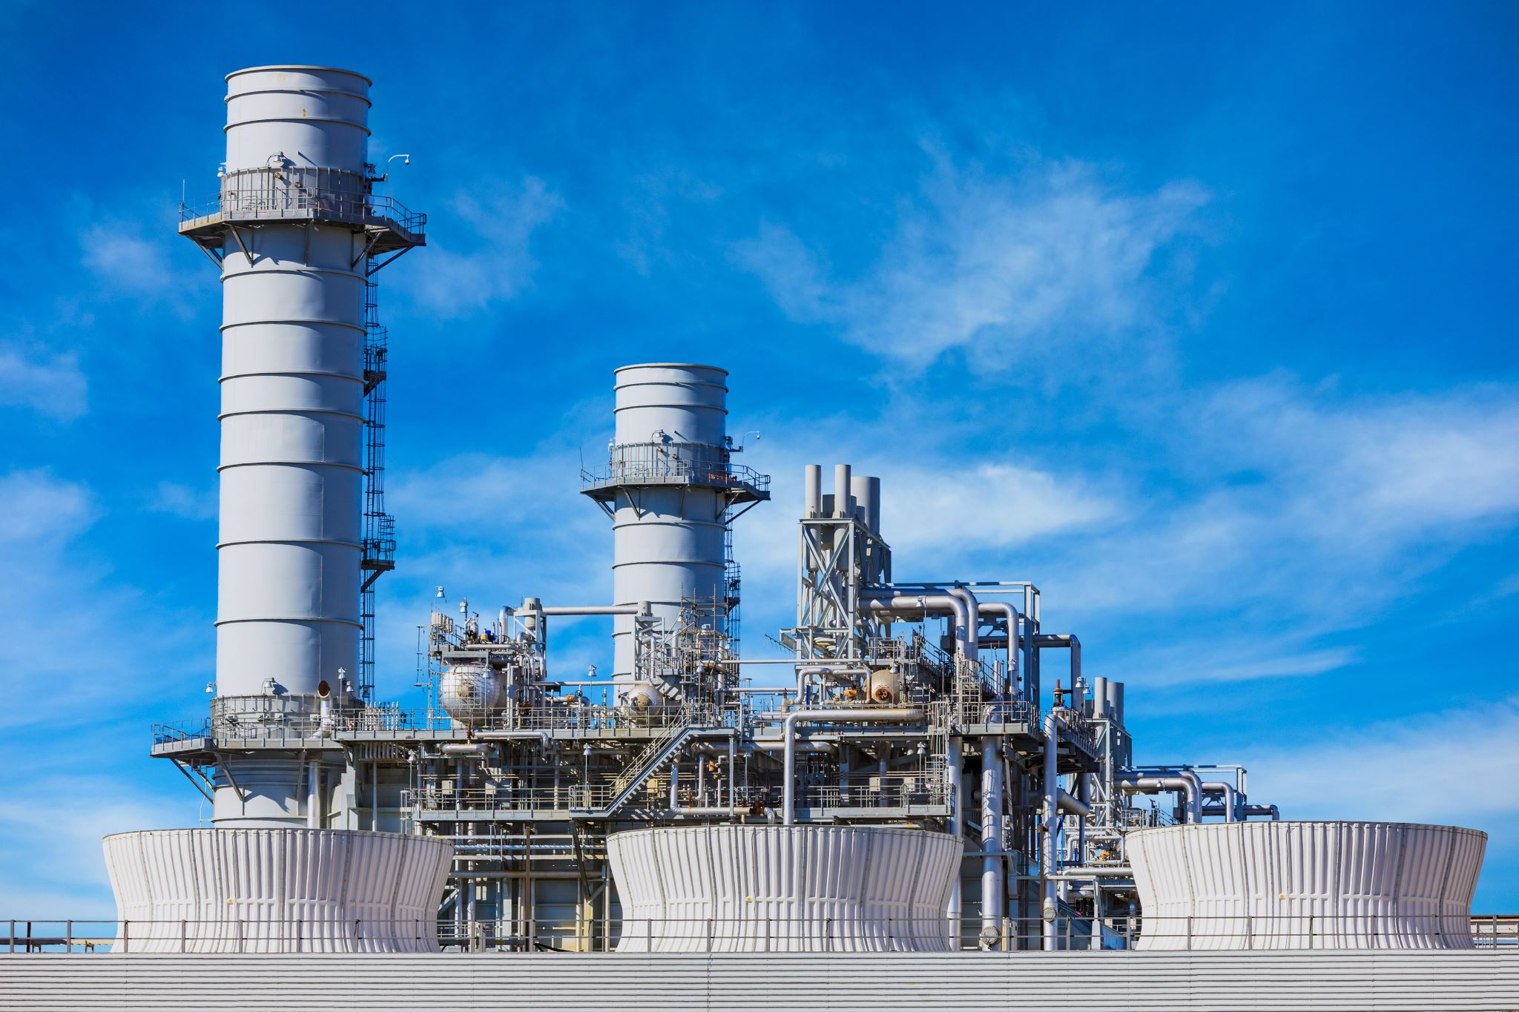
Predicting Cooling System Performance in Power Plants Using CNN and RNN Models
Team Name: Cascaders
Presented By: Shabana Shaik (11766712)
Shabbeir Ahammad Shaik (11659107)
Sai Swetha Puli (11688269)

Slide 2

Contents:
Introduction
Objective
Problem Statement
Data Collection & Data Dictionary
Exploratory Data Analysis (EDA)
Methodology Overview
Model Architecture:
CNN
RNN
Hybrid LSTM - CNN Model
Model Performance Comparison
Conclusion

Slide 3
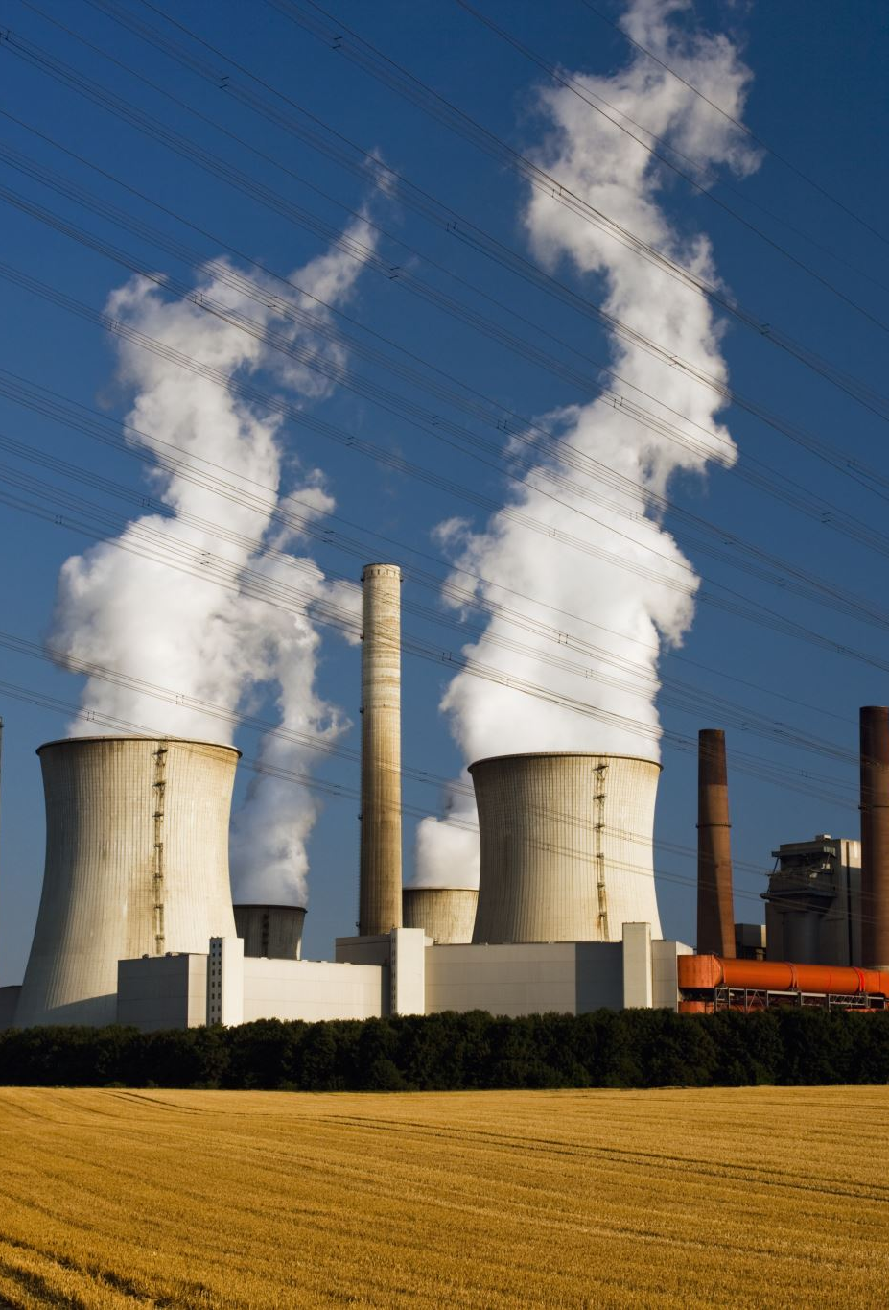
Introduction:
Cooling systems are heart for the power generation plants which impact directly on operating power, usage of water, and environmental things.
Prediction of a cooling system is more important to reduce costs and resources. This project uses the advanced deep learning models to predict and forecast the efficiencies of the cooling systems.

Slide 4

Objective:
The main aspect and view of this project is to define and build a deep learning projects that can accurately predict and forecast the efficiencies of the colling systems by using the metrics with variables such as water consumption intensity , and turbine related variables which can reduce cost and increase the sustainability

Slide 5
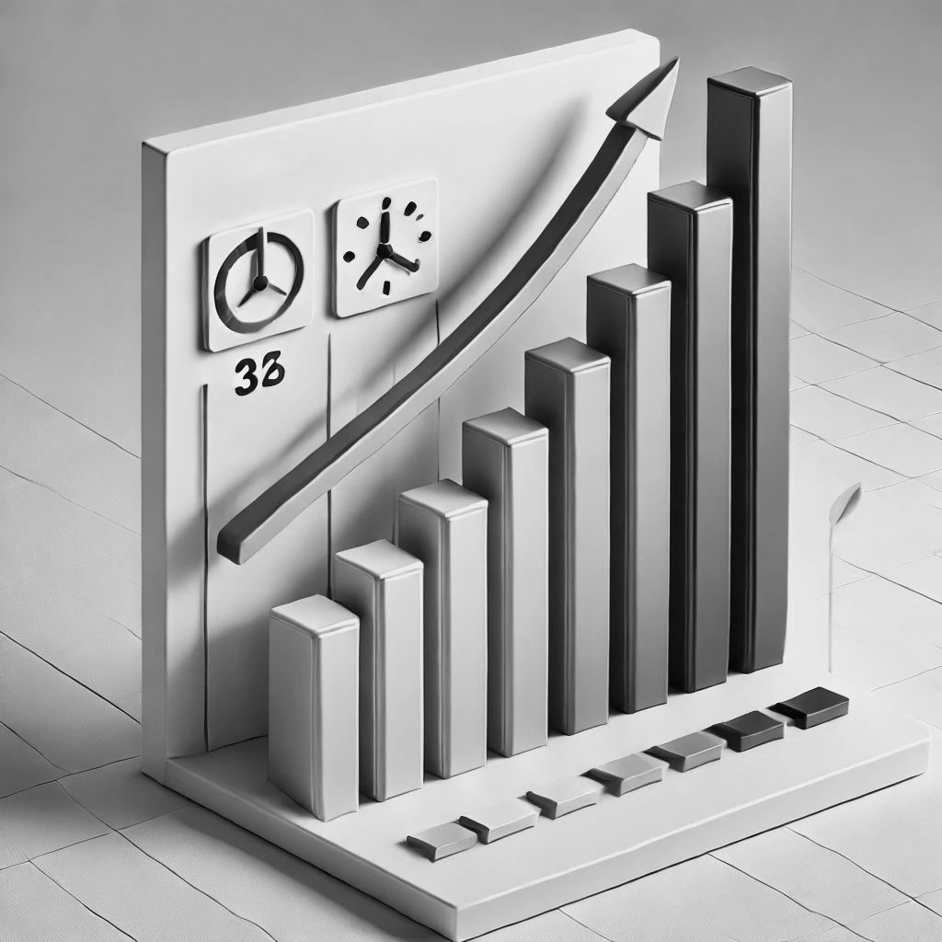
Problem Statement:
Our Aim is to Address the efficiencies of the cooling systems using advanced machine learning techniques such as CNN, RNN & Hybrid LSTM-CNN

Slide 6

Data Collection & Dictionary:
Data Collection: Dataset is collected from data.gov
Utility ID: Unique identifier for power providers.
Plant Name: indicates power plant name
Cooling System Type: Cooling systems type
Water Consumption Intensity Rate: Gallons/MWh.
Gross and Net Energy Generation: MWh metrics.
Fuel Consumption: Energy source consumption in MMBTU.
Environmental Factors: Temperature, humidity, water type.
State and Month: Represent geographic and seasonal variations in cooling demands.

Slide 7
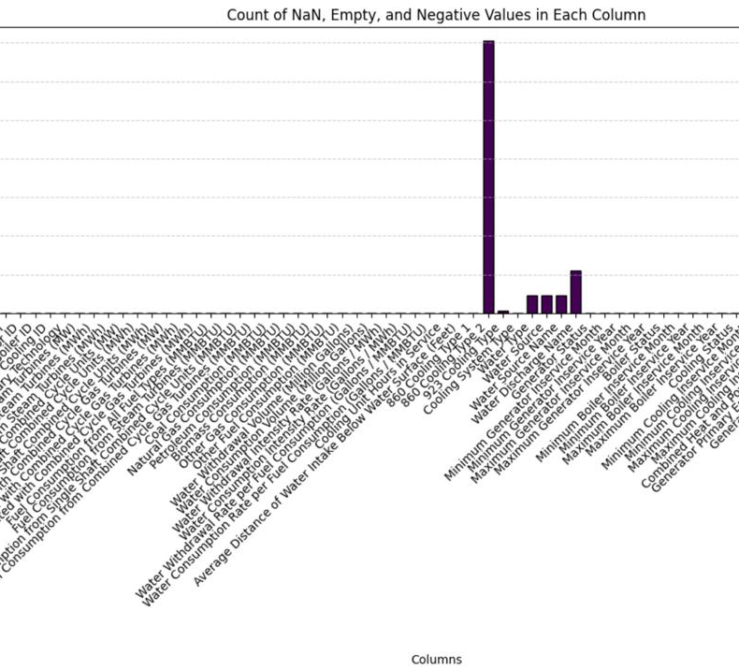
Exploratory Data Analysis (EDA):
Handling Missing values
Removing Duplicates
Handling Outliers
Encoding Categorical variables
Scaling & Normalization
Feature engineering
Feature selection
Splitting data into training & testing.
Model Architecture: CNN, RNN, Hybrid LSTM – CNN models

Slide 8
Model Architectures:
Convolutional Neural Network:
Recurrent Neural Network:
Hybrid LSTM - CNN:
Training Process:
From the overall dataset 80% of the data is given for training and 20% is given for testing.

Slide 9
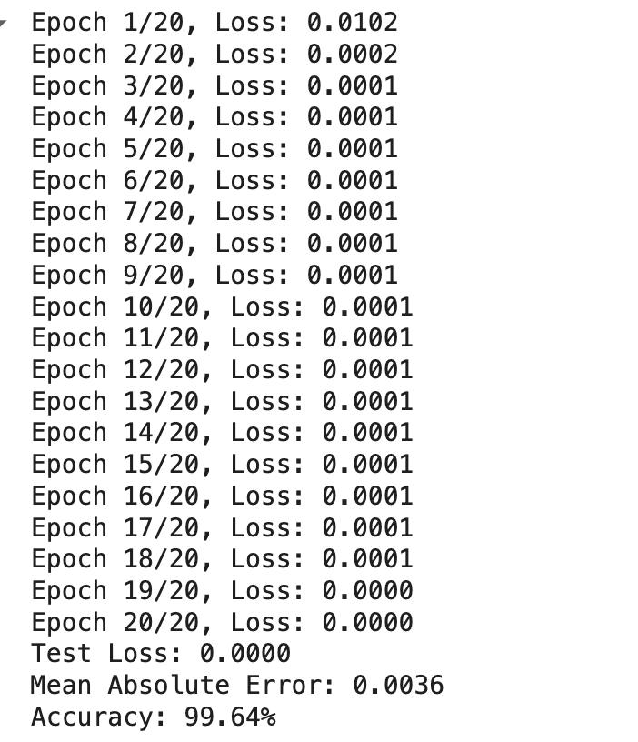
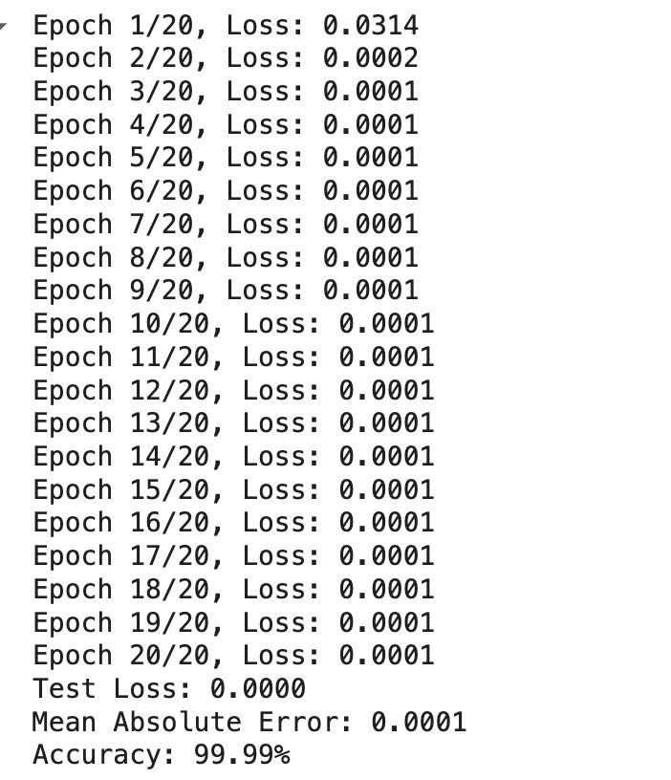
CNN:
RNN:

Slide 10
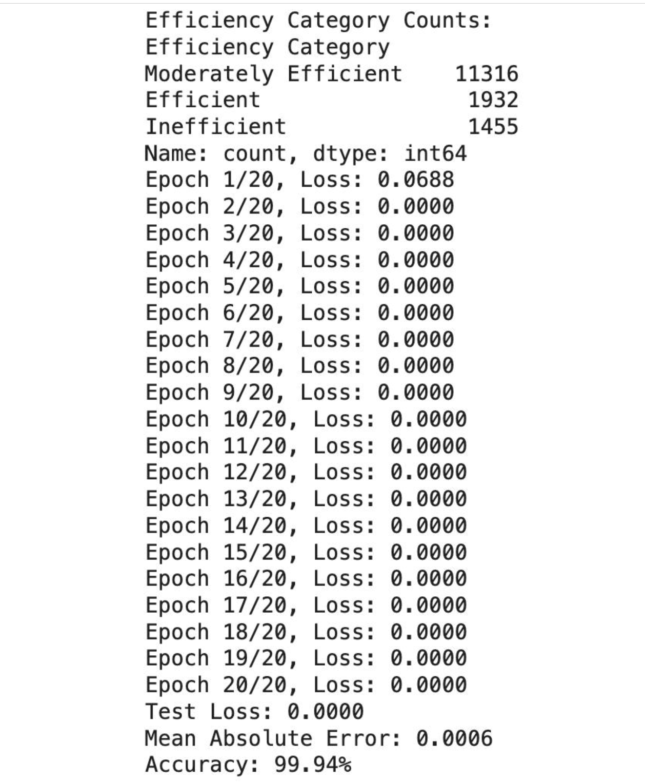
Hybrid LSTM-CNN Model

Slide 11
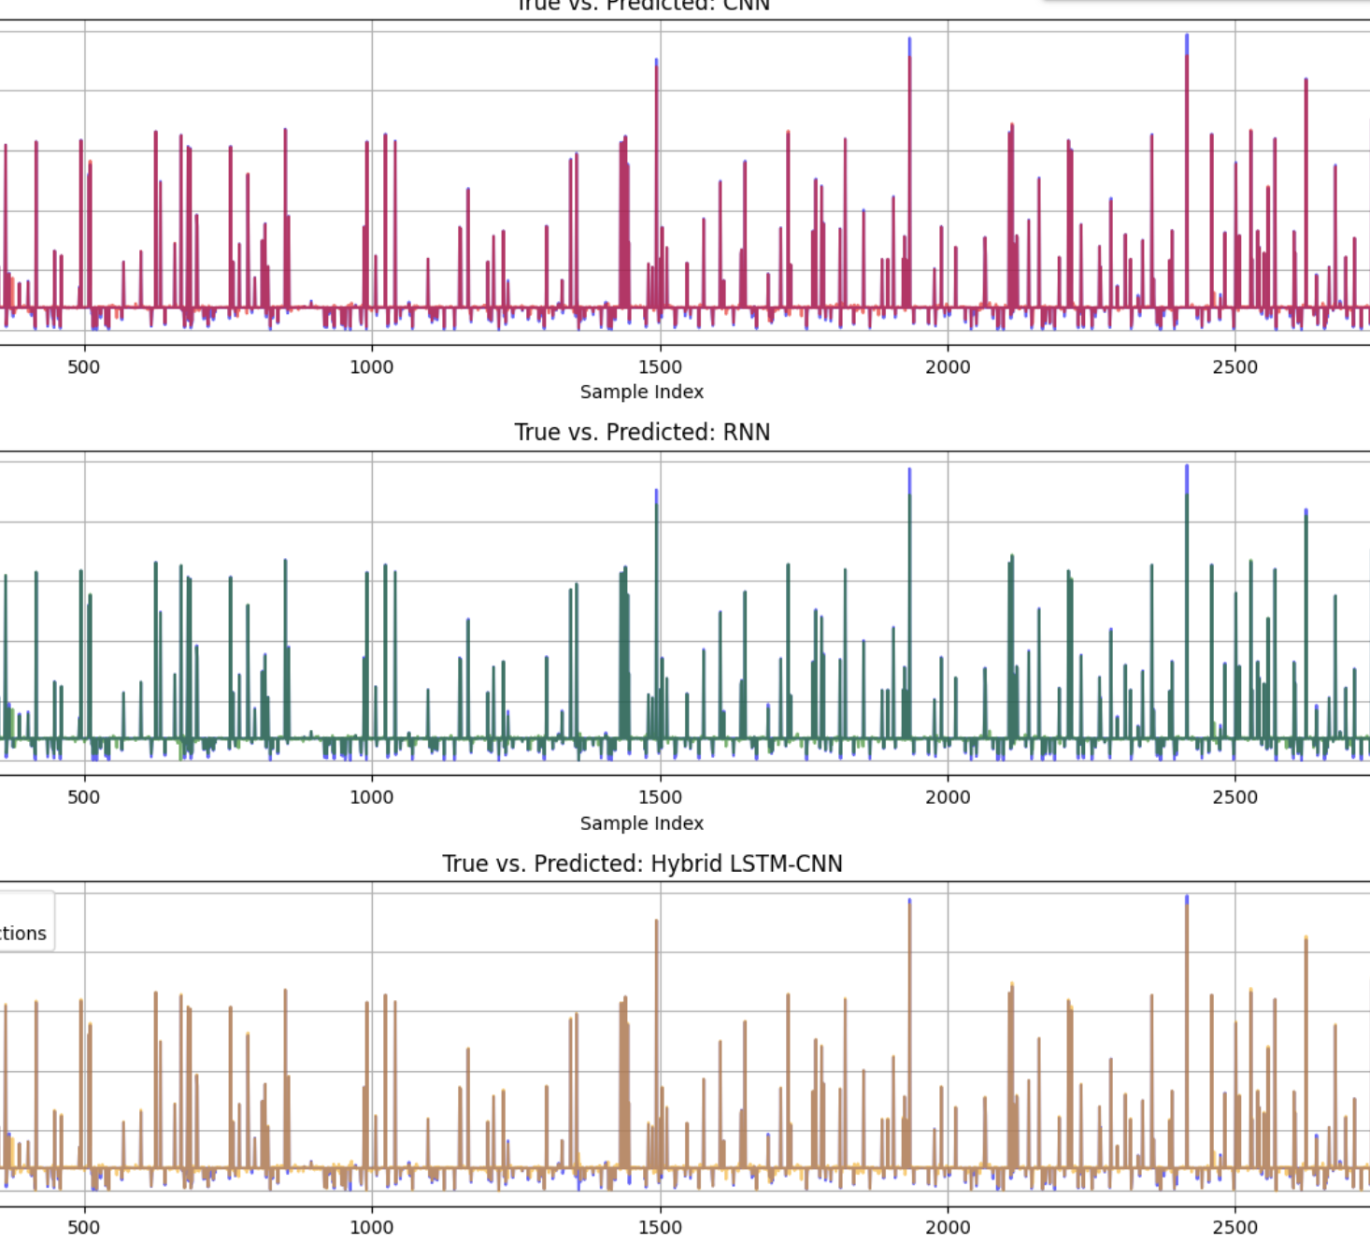
Model comparision :
Out of these models Hybrid LSTM-CNN matched the values which are correct and predicted efficiently indicating the best performance

Slide 12
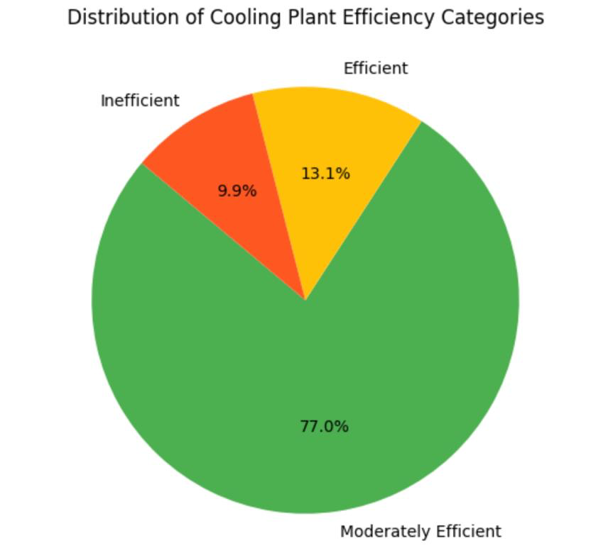
Key findings:
Out of these finding we came to conclude that most of the power plants are moderately efficient and a few plants are operated efficiently and some of the cooling systems are inefficient which needs to be addressed immediately

Slide 13
Thank You!

